Slide 1


Exploring New York City's Diverse Food Cultures for Tourism Purposes
Shabbir Ahmad Presentation
for
Applied Data Science Capstone Project April 29, 2020

Slide 2
Introduction / Problem Statement
New York City (NYC) is the largest metropolitan area in the world
Over 65 million tourists visited NYC during 2019
Tourists often find it difficult to find the restaurants and eateries of their choice in those areas.
Tourists are also overwhelmed by the food choices and the decision-making process may be time consuming.
This project explores the boroughs of NYC and locate all the possible food options in different neighbourhoods of the city.
Different types of cuisines are located in the city.

Slide 3
Data Description
Data Requirements
Data related to boroughs (including neighbourhoods) of New York City is required for this project.
Specific data regarding different locations are extracted from Foursquare API.
Libraries like pandas, numpy, matplotlib, folium (for mapping), and pickle are employed for data processing.

Slide 4
Data Description
New York City dataset: This dataset provides the addresses of neighbourhoods of the city. A json file is extracted from this link https://geo.nyu.edu/catalog/nyu_2451_34572
Foursquare API: It is a location data provider and will be used to make API calls to extract data regarding different venues in New York City’s neighbourhoods. To access the API, ‘CLIENT_ID’, ‘CLIENT_SECRET’ and ‘VERSION’ will be defined. This link is used. https://developer.foursquare.com/docs/

Slide 5
Stakeholders/Audience
The audience of this report are mainly local and foreign tourists in New York City who would like to find the eatery of their choice conveniently or explore the diverse food choices available at a particular locality.
Findings of this report can also be used by the tourism department of the city as well as by tour operators to guide the tourists regarding the locations of the diverse food options.

Slide 6
Methodology
Downloading and exploring the dataset
The dataset is downloaded from the aforementioned URL.
The URL returns the .json file containing the dataset in the form of a python dictionary.
The requisite data i.e. the list of five boroughs and the neighbourhoods within these boroughs, is in the features key.

Slide 7
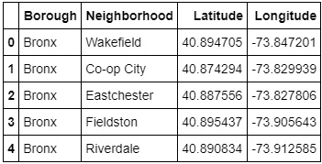
Methodology
Dataframe ‘neighborhoods’ is created.
First 05 rows of the dataframe

Slide 8
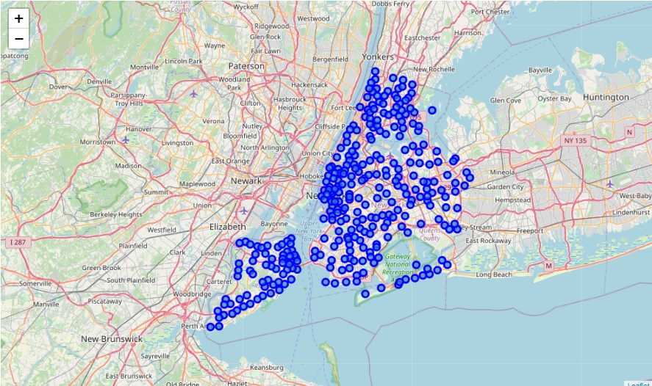
Methodology
The dataframe is further used to generate a map of New York City with neighbourhoods superimposed on top. The map is generated by using the ‘folium’ library.

Slide 9
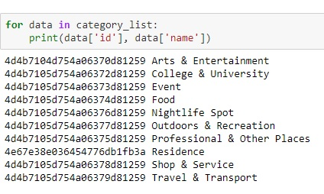
Methodology
Foursquare API
After extracting Foursquare venue category hierarchy, a list of ten categories of venues is generated but we are only interested in ‘Food’

Slide 10
Methodology
Dataframe ‘nyc_venues’
Instead of using GET request for all neighbourhoods to extract information regarding latitude and longitude, a function ‘getNearbyFood’ is created.
It creates an API request URL with radius = 500, LIMIT = 100. Limit is set to 100, so that a maximum of 100 venues are returned in the vicinity.
A new dataframe is created for information regarding all the 306 neighbourhoods.
The dataframe has 13612 venues and 187 unique sub-categories.

Slide 11
Methodology
Data Cleaning
Among the 187 categories of food, general categories like ice cream shops, cafes and bars are also included. We need to eliminate these to make our work easier.
List of general categories is created and then subtracted from all the categories. It leave us only the restaurants and eateries.
After this process, we have 101 unique categories.

Slide 12


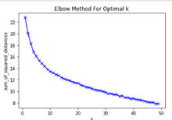
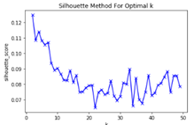
Methodology
Data Processing - Clustering through K-Means
To find the optimal number of clusters, The Elbow Method and The Silhouette Methods are used. The latter provides a better solution.
K = 8

Slide 13
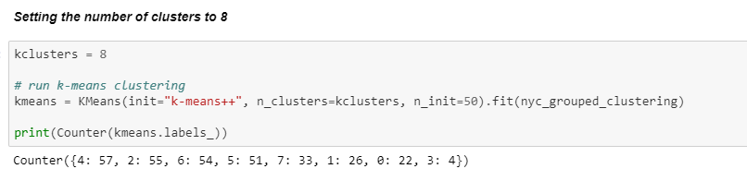
Methodology
Each cluster got the following number of neighbourhoods. Cluster 4 has the highest number (57) while Cluster 3 has the lowest (04).

Slide 14
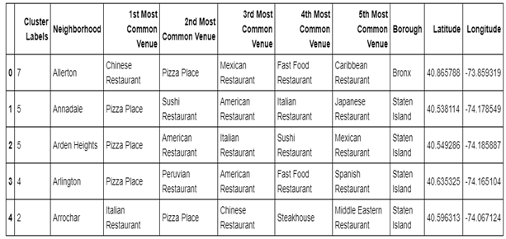
Methodology
Adding Borough, Latitude and Longitude for each neighbourhood to get a complete set of information regarding the venues available in different neighbourhoods.

Slide 15
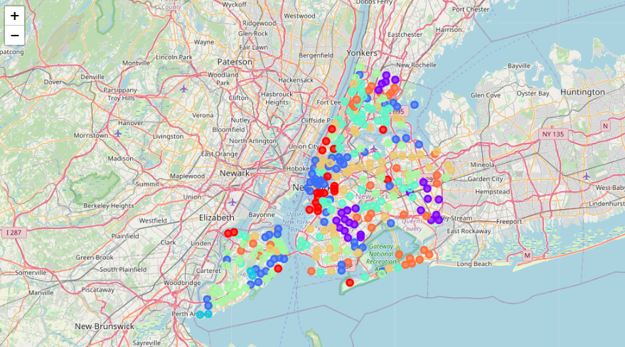
Methodology
Neighbourhoods clusters look like this

Slide 16
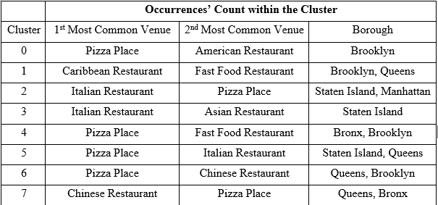
Results
The first and second most common venues are determined in the eight clusters. Here is a summary of the occurrences.

Slide 17
Discussion
K-mean clustering algorithm is used to segment New York City’s neighbourhoods.
The optimal number of clusters is eight for this project as found out through ‘The Silhouette Method.’
Each of these clusters is analysed through determining the borough count, count of ‘First Most Common Venue’ and ‘Second Most Common Venue.’
Pizza is the most common food in New York City. Since it is considered as go-to food, we can set it aside and regard Italian food as the most common cuisine. Caribbean, Chinese, Asian and American foods are also common in different areas.

Slide 18
Conclusion
Project is aimed at exploring the boroughs of New York City to locate the most common food options in different neighbourhoods.
Data is collected from ‘New York City Dataset’, processed and cleaned through different python libraries. K-mean clustering algorithm is used to segment the data into clusters.
After analysis, we find out that Pizza is the most common food.
Keeping in view the ubiquitous nature of this and other fast foods, it is set aside, and conclusion is drawn on the basis of most common foods next to pizza.
American, Italian, Caribbean, Chinese and Asian cuisines are most common in the city.

